Slide 1
Renesas Synergy platform ™ security built IN
Nick mori
Renesas Electronics corporation
Broad based solution b.U. , synergy platform div.
1/8/2018

Slide 2
AGENDA
Understanding IoT Security Requirements
Solving IoT Security with Synergy
Synergy platform resources
Secure Level Planning
Secure Boot Loader Reference Project
Implementation plan
Secure Connectivity
Summary

Slide 3
Understanding security
requirements

Slide 4

Critical components of IoT security
Confidentiality
Employs cryptography to limit access to information
Confidentiality
Availability
Integrity
Guarantees reliable performance under all conditions
Assures platform is trustworthy and data is accurate
Integrity
Availability

Slide 5





Focused Security Challenges for IoT
Protect Intellectual Property
IP Theft
Cloning
Over-building
Protect Data
In Flight & At Rest
Privacy
Confidentiality
Enable Big Data
Create Robust Foundations
Root of Trust
Identity
Authentication
Authorisation
Separate Critical
Functions
Protected Mode
Fail Safe
Secure Services
Manage Device Lifecycle
Lifetime Support
Critical Updates
Feature Enable
Confidentiality
Integrity
Availability

Slide 6
Solving IoT Security challenges
using Synergy

Slide 7



Synergy Core Security
Functions |  |  | Confidentiality | Integrity | Availability
Key Protection / Storage / Isolation |  |  | ✓ | ✓ | ✓
Cryptographic Services | True Random Number Generator |  | ✓ | ✓
 | Ciphers | Symmetrical | ✓
 |  | Asymmetrical |  | ✓
 | Hash |  |  | ✓
Certificates / Chain of Trust |  |  | ✓ | ✓
Secure Boot / Remote Firmware Update |  |  | ✓ | ✓ | ✓
Device Lifecycle Management |  |  |  | ✓
Data Protection (Key and data wrapping) |  |  | ✓ | ✓
Secure Communication (e.g. TLS, MQTT) |  |  | ✓ | ✓ | ✓
Core Security
Advanced
Security

Slide 8
Synergy platform resources

Slide 9




MCU Hardware Security Features
Function
Secure Crypto Engine (SCE) Performance Acceleration NIST CAVP (Cryptographic Algorithm Verification Program) certifications in process Low Power Small firmware memory footprint Key isolation / wrapping¹ | ✓ | ✓ | ✓ Symmetrical encryption only
Secure Memory (Security MPU²) Sensitive code and data isolated in a separate domain | ✓ | ✓ | ✓ | ✓³
One-Time Programmable Memory (FAW⁴) Allows code (e.g. boot code) and data (e.g. root keys, configurations) to be protected against being changed. | ✓ | ✓ | ✓ | ✓
Limited JTAG access | ✓ | ✓ | ✓ | ✓
¹Keys are encrypted with a key unique to each MCU, so they are only accessible within the crypto module on a particular MCU
²Memory Protection Unit – Secure memory isolated from non-secure memory at the hardware level
³ S124 does not support Security MPU
⁴Flash Access Window – After initialization, only certain portions of flash memory can be written (i.e. initialized data can be locked for the product lifetime)
Notes:
TSIP
Performance: Hardware acceleration is provided for all cryptographic features that are available on that SKU. This results in improved price/performance/power consumption. This can have a significant impact on communications (TLS) efficiency. It will likely also improve boot and application flash update performance.
Key Security: Keys can be wrapped so they are never exposed outside the crypto module and cannot be stolen from the device as they will only work on the same MCU. (i.e. No “dead copy”);
Secure Memory
The bulk of the application is typically non-secure. Keys are typically stored in a secure portion of the memory.
Any code that accesses those keys (or wrapped keys) and controls access to the use of those keys is also stored in a secure portion of the memory
Never put the entire app in secure memory as you want to reduce the “attack surface”. For example if somebody hacks into the TCP/IP stack or the protocol of the TLS stack, they won’t have access to the keys.
OTP Memory: Typically used during manufacturing where the secure boot loader and associated data (e.g. OEM Identity keys) are secure against being modified.
Soft PUF Option address shortly below

Slide 10




Synergy hardware cryptography features
Functions |  | S7 | S5 | S3 | S1
RSA |  | 1024/2048 | 1024/2048
DSA |  | L:1024,N:160 | L:1024, N:160
 |  | L:2048, N:224 | L:2048, N:224
 |  | L:2048, N:256 | L:2048, N:256
AES | ECB | 128/192/256 | 128/192/256 | 128/256 | 128/256
 | CBC | 128/192/256 | 128/192/256 | 128/256 | 128/256
 | CTR | 128/192/256 | 128/192/256 | 128/256 | 128/256
 | GCM | 128/192/256 | 128/192/256 | 128/256
 | CCM | 128/192/256 | 128/192/256
 | XTS | 128/192/256 | 128/192/256
TDES | ECB | 168 | 168
 | CBC | 168 | 168
HASH | SHA1 | ✓ | ✓
 | SHA256 | ✓ | ✓
True Random Number Generator TRNG |  | ✓ | ✓ | ✓ | ✓
Identity (Asymmetrical)
Confidentiality (Symmetrical)
Integrity
Notes:
The lower end SKU’s(S1, S3) only provided for symmetrical encryption (E.g. Confidentiality with shared secret keys) and the higher end SKU’s (S5, S7) provided for asymmetrical encryption (E.g. Trust and symmetrical encryption with temporary symmetrical keys).
Note that Identity functions consume the most power, but are done typically only periodically (e.g. once every few hours or once a day). However, in some applications they may occur more often.

Slide 11
Security MPU
Memory Protection Units
Provides regions that can only be accessed by “secure code”
Secure regions are protected from unauthorized accesses by:
A non-secure program
Masters, such as the DMA, DTC
From debugger
Allows untrusted code to operate along side trusted code
The Setting is stored in Flash
The Security MPU is activated before fetching the reset vector
Bus Master MPU
Bus Slave MPU
Security MPU
Program Counter
PC Region 0
PC Region 1
Monitor of D Code Bus
CPU Bus
Region 0
Mask of Access
Region 1
Monitor of System Bus
Region 0
Mask of Access
Region 1
Region 2
Monitor of Group A, B, C
Region 0
Bus of Master Group A,B,C
Region 0
Region 1
PC Region 0
Region 1
Mask of access
Region 2
Region 1
Region 2
Region 3
Region 2
Region 3
Region 3

Slide 12
Flash Access Window
Flash Area Protection
Write-protects an area within the User flash to prevent undesired self-programming
Area protection can be enabled only during self-programming in single-chip mode per block basis
Setting is stored in Option Flash
Once the lock bit (AWSC) is enabled, the setting is frozen
Block N
…
Protected
0x4000
Block 7
0x3FFF
Block 6
End Block
Block 5
Access Window
Accessible
0x2000
Block 4
0x1FFF
Block 3
Start Block
Block 2
Block 1
Protected
0x0000
Block 0

Slide 13
Protection by FAW and Security MPU
User Flash
OTP & Protected from Non-Secure code(A)
Define R/W access protection area
Protected area cannot be accessible
Suitable for secure boot loader and signature keys
Protected from Non-Secure code, Programable (B)
The data in this region is protected from non-secure program
However, it can be re-programmable
It can be considered as secured programmable area
Suitable for keys and secure program that need to be updated during the lifecycle
Application code, Programmable (C)
Regular programmable area
Suitable for Firmware application that can be updated in field
(C)
Accessible
Programmable
Flash
Access
Window
(B)
Not accessible
Programmable
Security
MPU
(A)
Not accessible
Not programmable

Slide 14
Wrapped Key Crypto API
Generate Encrypted Key
AES Key Wrapping Interface APIs
Generate key-wrapped AES key
Encrypt data using key-wrapped AES key
Decrypt data using key-wrapped AES key
RSA Key Wrapping Interface APIs
Generate RSA key-pair, key-wrap private key
Verify/Encrypt data using RSA public key
Sign/Decrypt data using key-wrapped RSA private key
Wrapped Key can be stored in non secure storage
The wrapped key is only valid on the device that wrapped
SCE
HRK
(Hidden Root Key)
RNG (Generate plain key)
Encrypted with HRK
Key Wrapped Key
Use Wrapped Key
SCE
HRK
(Hidden Root Key)
Key Wrapped Key
Plain-text key
Decrypted with HRK
Plain Text
Encrypted Text
Encrypt with plain key

Slide 15
Key storage schemes
Unprotected
SCE wraps key with its unique key
Key Generation
Secure Key Injection
MPU Protected
Raw Key in protected memory
SCE
Raw Key is generated from TRNG

Slide 16
Security components in synergy
Microcontroller
Secure Crypto Engine
Security MPU(memory protection unit)
Flash Access Window
Secure Boot Loader (Option)
Maintain integrity of software on Microcontroller
If updated firmware is pending, flash it securely
Crypto Library included in SSP
High level API for using Crypto hardware accelerator
Security Protocol stack
TLS
Firmware Update (Option)
Download updated Firmware
Application
Firmware Update
Synergy Software Package (SSP)
ThreadX®
RTOS
FileX®
GUIX™
USBX™
NetX™
NetX Duo™
Application Framework
Functional Libraries
TLS
Crypto Library
HAL Drivers
BSP
Secure Boot Loader
Synergy Microcontrollers
Security MPU
Flash Access Window
Secure Crypto Engine
Notes:
A summary of items previously discussed. Also show the OS (e.g. ThreadX a real time operating system) and other related features (FileX, GUX, etc.)

Slide 17
Security level planning

Slide 18




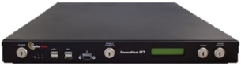


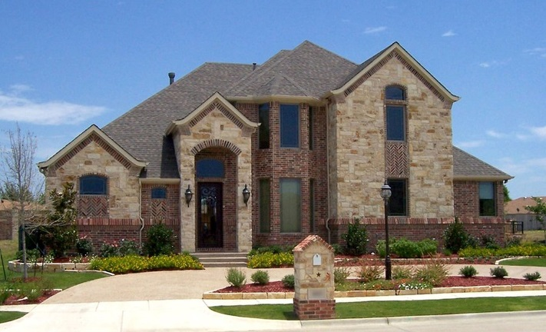

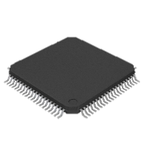


Life cycle management
Update Firmware Server
OEM
OEM
Secure
Boot loader
Application
Firmware
OEM
Bare MCU
End Product
Renesas
Contract Manufacturer
End User

Slide 19
Security challenges
Threat | Solution | Comments
Device Malware Device malfunction causing direct injury or damage “Backdoor” into networking causing injury or damage/loss | Secure Boot / Flash Ensure firmware is authentic, unmodified, and can’t be rolled back to a version with security vulnerabilities | Requires mastering tools (for OEM to sign and optionally encrypt firmware) and infrastructure for manufacturing Option: Most OEM’s also need infrastructure for securely updating firmware in the field
Device IP theft, Cloning, Vulnerability Analysis | Secure Boot / Flash + IP Protection Option | Requires additional infrastructure for encrypting individual keys for each device during manufacturing and field updates
Data-in-Motion (Device <-> Cloud) Spoofed identity Data is modified Data is replayed Eavesdropping or theft of data | TLS | Standard protocol which supports authentication of Cloud-By-Device and optionally Device-By-Cloud
Data-at-Rest (On Device) Application Specific Requirements: Protecting data when it’s on the device Encrypting/protection data before sending to cloud (e.g. encrypted for specific targets) Application specific protocols Other | Security Services / Toolbox Crypto API’s, TRNG, Secure Key Storage, reference examples
Cloud Connectivity
¹The TLS Identity will not be issued unless the Secure Boot / Flash identity is validated. Or alternatively the Secure Boot / Flash identity is used as the TLS identity.

Slide 20
Secure boot / flash firmware solution tiers
Security Tier |  | Integrity Validate firmware on flash and boot Firmware is authentic Not modified | Identity with Certificates Securely provisioned and stored Unique ID for each device allows: Attest/prove to the Cloud that the device is trusted Device-to-Cloud trusted communications (e.g. Chain-of-trust to TLS device identity) | IP Protection Firmware is encrypted by OEM and decrypted inside MCU target Firmware can only be flashed to selected number of devices (e.g. to prevent cloning/overproduction)
0 | No Security
1 | Secure Boot / Flash | ✓
2 | Trusted Device | ✓ | ✓
3 | Trusted Device w/ IP Protection | ✓ | ✓ | ✓

Slide 21

Tier 0 – No security
MCU
OEM Firmware Release Tools
Data Center
FW Update Infrastructure
Read protected
Security
Physical
Cryptographic
Write protected
OTP @ Initial Flash
None Required
Manufacturing Programming Center
Cloud Operations
Programmer

Slide 22
Tier 1 – Secure Boot
MCU
OEM Firmware Release Tools
Data Center
FW Update Infrastructure
Read protected
Sec Boot Loader
Create OEM Secured Identity
Validates Firmware Signature
Security
Firmware Signed with Private Key
Physical
Cryptographic
Write protected
OTP @ Initial Flash
None Required
Manufacturing Programming Center
Cloud Operations
Programmer
Sec Boot Loader
Setup Boot Loader with OEM Identity used to validate releases

Slide 23
Tier 2 – trusted device
MCU
OEM Firmware Release Tools
Data Center
FW Update Infrastructure
Read protected
Sec Boot Loader
OEM ID
Security
Physical
Cryptographic
Write protected
OTP @ Initial Flash
None Required
Manufacturing Programming Center
Cloud Cert Authority
Cloud Operations
Programmer
Cert Authority
(Typically hosted in an HSM¹)
Sec Boot Loader
OEM ID
Centralized Cert Lifecycle Management Option
Expire / renew cert
Invalidate and/or authorize new delegate
Invalidate device cert manually (e.g. decommission device)
Analytics – detect compromised cert + cert invalidation and re-issuing
Can Issue certs only from Centralized OEM controlled facility
Option: Key Generation on Device¹
Delegate
Or Centralized
Cert Authority root certificate used to validate device identities
May be issued with local identity
OEM Identity is created and provisioned to MCU
(Key Injection)
Issues cert
(Using public key provided by Programmer)
Contains HSM¹
¹ Hardware Security Module – Computing appliance platform w/ extremely high physical security & cryptographic speed
² Private key never leaves MCU. Key pair is generated on the MCU, the public key is sent to the Programmer and a certificate is issued and sent to the MCU

Slide 24

Tier 3 – trusted device + IP Protection
MCU
OEM Firmware Release Tools
Data Center
FW Update Infrastructure
Read protected
Sec Boot Loader
OEM ID
..and decrypted with assoc. private key
HSM
..which decrypts firmware
FW Encryption Key
Secure code goes into secure memory¹
Security
Similar implementation in update infrastructure is required, except counter not needed (i.e. an existing device can always be updated)
Physical
Key is encrypted for each MCU using its OEM ID
Cryptographic
Encrypt firmware w/ key specific to release
Write protected
OTP @ Initial Flash
None Required
Manufacturing Programming Center
Cloud Cert Authority
Cloud Operations
Programmer
Cert Authority
(Typically hosted in an HSM¹)
Sec Boot Loader
OEM ID
Centralized Cert Lifecycle Management Option
Expire / renew cert
Invalidate and/or authorize new delegate
Invalidate device cert manually (e.g. decommission device)
Analytics – detect compromised cert + cert invalidation and re-issuing
Can Issue certs only from Centralized OEM controlled facility
Option: Key Generation on Device¹
Delegate
Or Centralized
May be issued with local identity
Transfer Key which can be used limited # times
Contains HSM¹
¹Only the portions of the code which access secure data (e.g. OEM ID, session keys) should go into secure memory (otherwise if all the code is in secure memory, any hack into the application could compromised the sensitive data)

Slide 25
Secure boot loader
referrence project

Slide 26
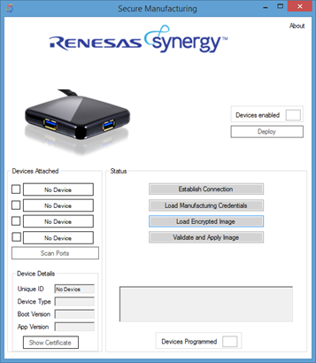
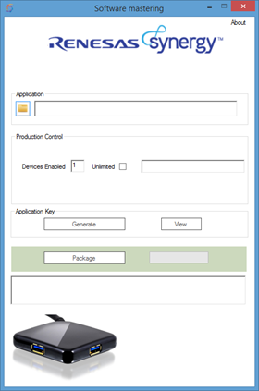
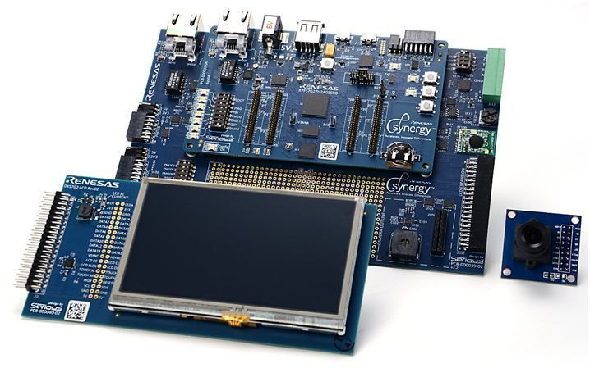
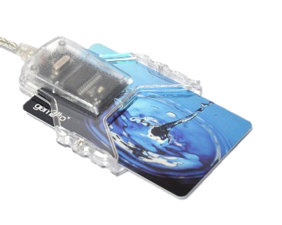
SECURITY Boot loader reference project
Secure Boot Loader and tools that support Security Tier 3 level
Example PC tools
Secure Boot Loader Packaging tool
Secure Boot Loader Installer tool
Key DB
Firmware Mastering tool
1st Time Programming tool
Deploy Update Firmware tool
Example device code
Secure Boot Loader
Sample SSP application with firmware update
Recovery manager
User’s Guide

Slide 27
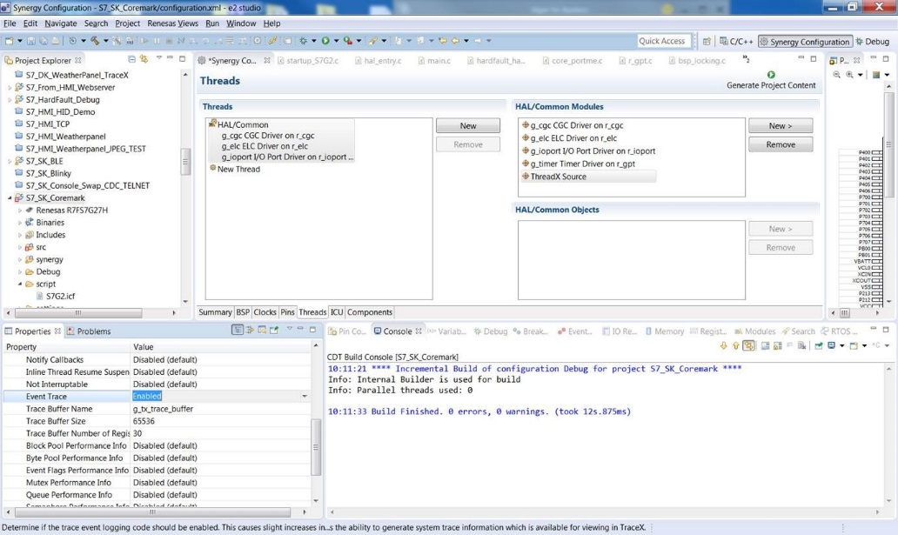
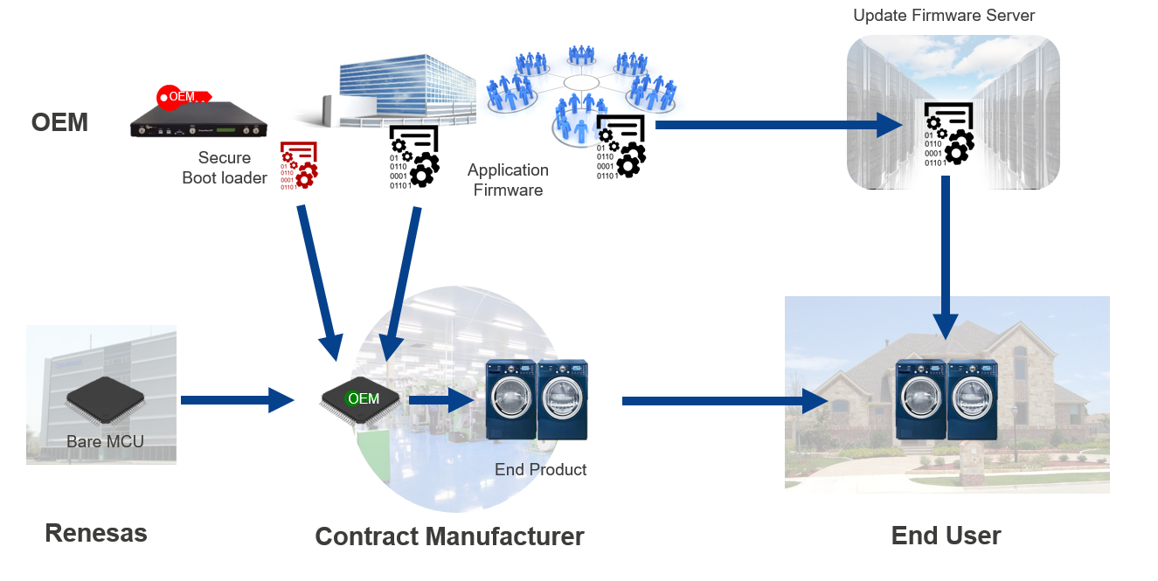
Build secure boot loader
Prepare Secure Boot Loader
Generate Signature key
Customize secure boot loader functionality if needed

Slide 28
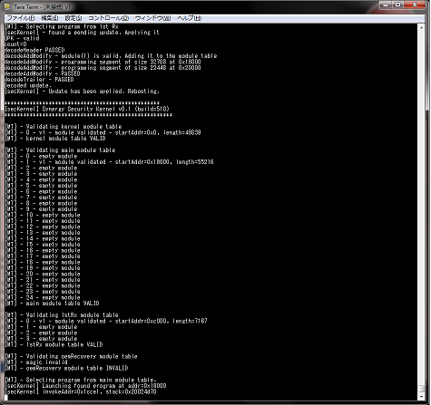

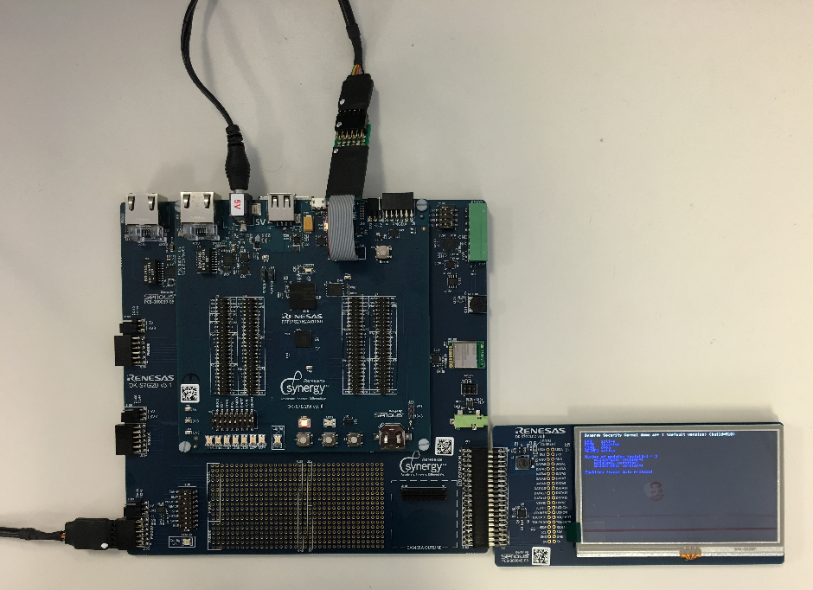
Device Personalization
Program Secure Boot Loader
Secure Boot loader and signature public key
Device Certificate
Enable protections
Security MPU
Flash Access Window
JTAG ACCEDD ID (Disable JTAG port)
After this personalization process, the device will accept only a binary image that is created by the Synergy Mastering tool
Log output
USB/UART convert cable
Download Secure Boot Loader
USB/UART convert cable
5V
Power supply

Slide 29
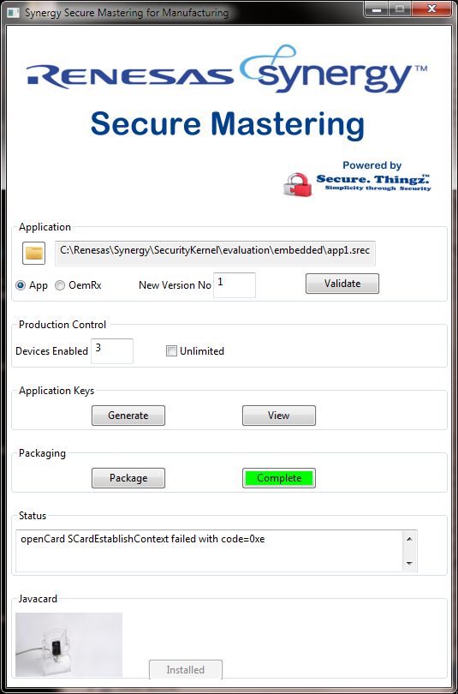


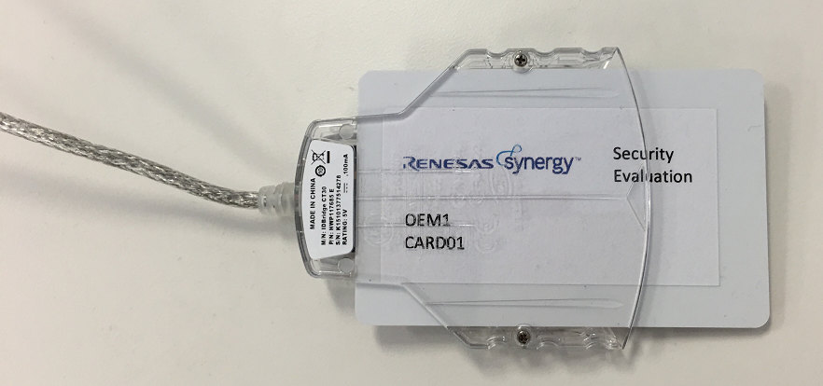
Mastering firmware
Generate UPK (Update Protection Key) and Save to Smartcard
AES Encryption Key for the Firmware
Signature Key for signing the Firmware
Sign Firmware image
Sign the Firmware by Signature key for the version 1.0
Encrypt the Firmware by the AES Encryption Key
UPK

Slide 30
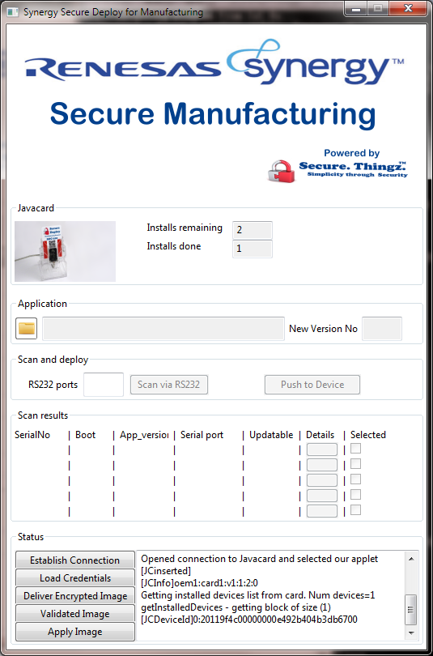
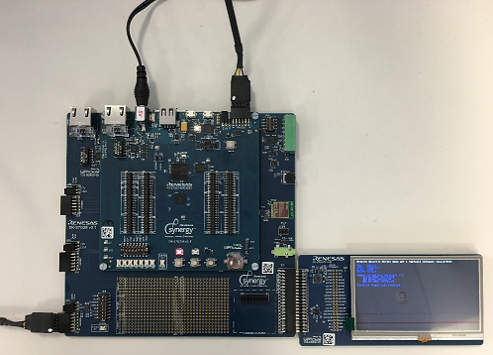
Deploy firmware
Authenticate Device
Device sends Device Certificate to the Deploy tool on PC
If successfully verified the Device Certificate, deploy tool encrypt UPK by Device Specific Encryption Key within the Device Certificate
Transfer UPK and Firmware to Device
Deploy tool transfer the encrypted UPK and encrypted Firmware to device
Program the Firmware
Security Boot Loader decrypt UPK and Firmware and Program decrypted Firmware within the Device
USB/UART convert cable
UPK
USB/UART convert cable
5V
Power supply

Slide 31
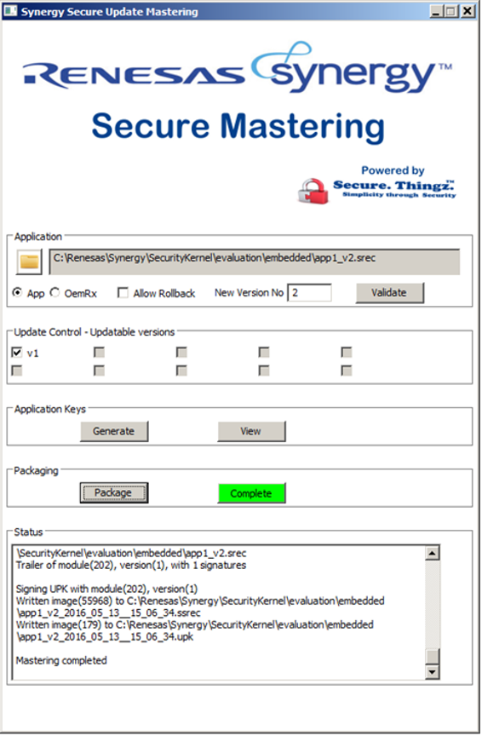
Mastering firmware for update
Generate UPK (Update Protection Key) and Save to Smartcard
AES Encryption Key for the Firmware
Signature Key for signing the Firmware
Sign Firmware image
Sign the Firmware by Signature key for the version 2.0
Encrypt the Firmware by the AES Encryption Key
Upload to Update Firmware server
UPK

Slide 32
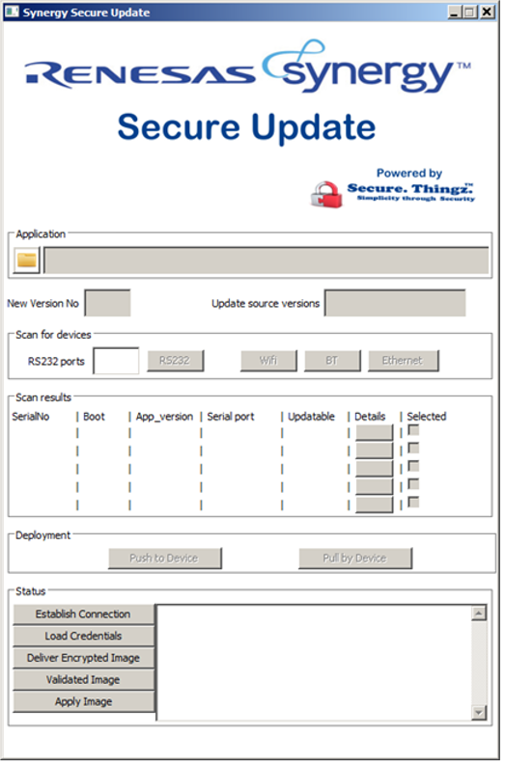
download firmware update
Authenticate Device
Device sends Device Certificate to the Deploy tool on PC
If successfully verified the Device Certificate, deploy tool encrypt UPK by Device Specific Encryption Key within the Device Certificate
Transfer UPK and Firmware to Device
Deploy tool transfer the encrypted UPK and encrypted Firmware to device
Program the Firmware
Security Boot Loader decrypt UPK and Firmware and Program decrypted Firmware within the Device
USB/UART convert cable
UPK
USB/UART convert cable
5V
Power supply

Slide 33
Implementation planning

Slide 34
Implementation planning5
Define security policy
Identifies threats
Identifies things to protect
Risk assessment when the security is compromised
Target Security Tier level
Based on security policy, decide Security Tier level
Design and Manufacturing process plan
Tier 1 or above requires secure(trusted) process for design and manufacturing
Tier 3 requires device unique key pair generation during the manufacturing, there is huge impact for manufacturing process
Requires appropriate secure environment for design and manufacturing
Memory map in MCU
Secure Boot Loader area
Application Firmware area
Firmware download buffer for Pending image
Healthy Firmware image back up

Slide 35
Security policy planning template
 | Development | Manufacturing, Warehouse, Transporting | In use by user, Maintenances | Discard, End of life
What to protect
Threat
How to protect
Cloud Connectivity

Slide 36
Security policy planning template – SAMPLE
 | Development | Manufacturing, Warehouse, Transporting | In use by user, Maintenances | Discard, End of life
What to protect | Firmware IP (Source code) Security assets (security keys, root of trust) | Firmware IP Root of trust Security assets Cloning | Firmware IP Root of trust Security assets End user information | Firmware IP Root of trust Security assets End user information
Threat | Unauthorized access External access Internal access | Unauthorized access External access Internal access Create Counterfeit product | Unauthorized access External access | Unauthorized access External access
How to protect
Cloud Connectivity

Slide 37
planning for secure boot implementation
Check point | Answer
Is there any confidential data belongs to user during the period that user is using the product? If yes, what?
Is there any confidential data/program when you ship the product? If yes, what, who owns?
How long is the product’s life?
Is the product connected to other device or network? If yes, what, how?
Do you need to identify each individual product in the field to manage product’s functionality?
Do you deploy firmware update to the product in the field?
Do you host the firmware update distribution server in Cloud?
Is any 3rd party involved for application on the product or service?
Do you intend to host the private CA for your product?
Do you need TLS in application?
In event of the product detect malicious behavior, what is the reaction?
Cloud Connectivity

Slide 38
planning for secure boot implementation
Check point | Answer
Is the software development team in one physical location?
Is the design site physically secure? Is there any access control?
Do you trust behavior of employees who have access to the design site?
Do you manufacture the product in trusted environment?
Do you trust behavior of employees who have access to the production facility?
Cloud Connectivity

Slide 39
Secure Cloud Connectivity

Slide 40

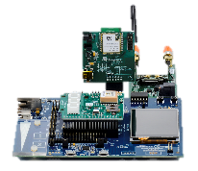
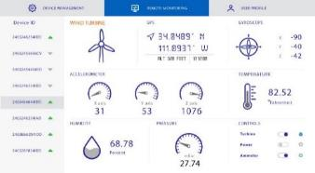
Secure IoT connection with Cloud
Basic building blocks of secure connectivity
Cloud Service
MQTT / TLS
RESTful API
Renesas Dashboard
Monitor and Control
Dashboard
“Thing”

Slide 41
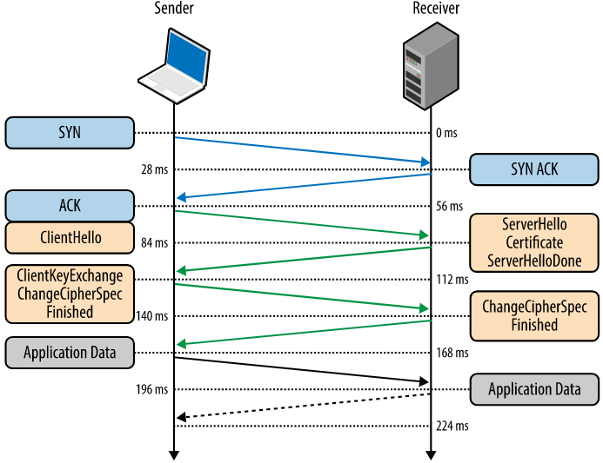

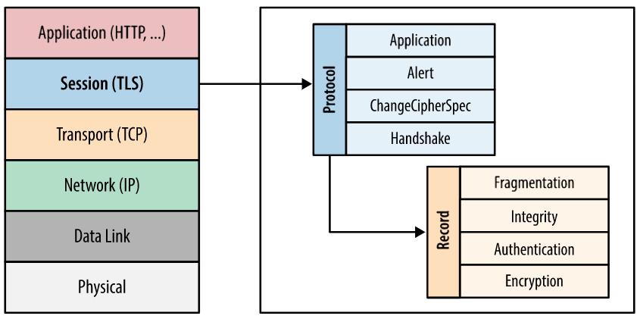
NetX Secure™
Transport Layer Security - TLS v1.2
Fundamental part of secure on-line communication. This is what your bank is using.
Socket layer security with NetX Duo™
Security 3 ways-
Secrecy – TLS establishes secret keys between client & server using RSA and uses crypto algorithms for payload such as AES
Integrity – Alteration or forgery of TCP packet content is detected using hashing algorithms such as SHA-1
Authentication – Ensure data is communicated only to intended target. Prove identity of remote host by using digital certificates
Initial TLS Handshake establishes ciphers & hashes for the session
Once session is established, communication is accompanied by records that ensures integrity.
Notes:
Everybody is talking about secure communication and there are very good reasons for that. So many companies with huge databanks have been hacked and data has been intercepted and decoded when not protected sufficiently. Renesas listened to customers and added TLS in the NetX Secure software. It is so important for our platform to offer secure on-line communication that Renesas decided to include TLS (and MQTT for that matter) in SSP 1.30.

Slide 42
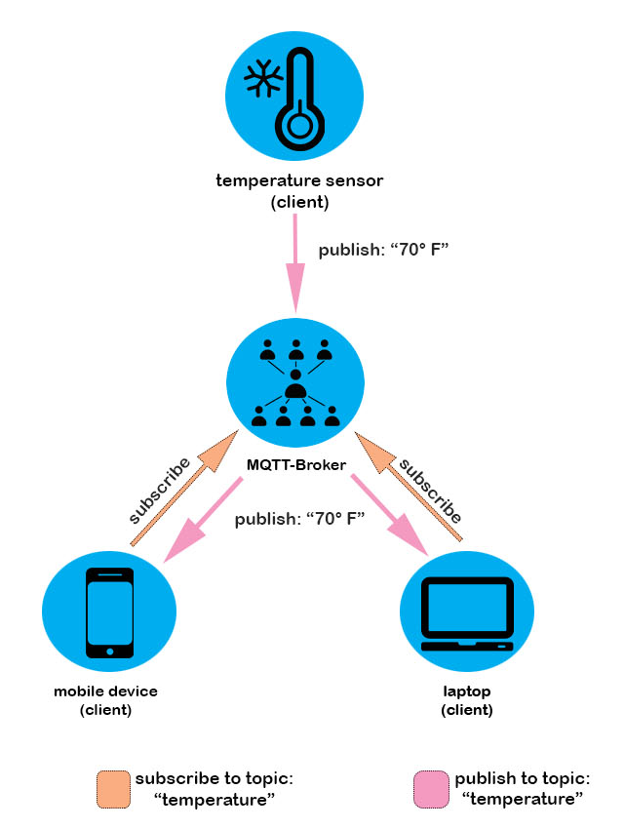

MQTT for NetX Duo™
Message Queue Transport Telemetry (MQTT)
Designed for lightweight M2M communications
Memory constrained devices, typically MCUs
Low-bandwidth, high-latency or unreliable networks
Publish/Subscribe model – Perfect for IoT devices
Publisher and subscriber do not need to know each other (by ip address and port for example)
Publisher and subscriber do not need to run at the same time.
Operations on both components are not halted during publish or receiving
Notes:
MQTT is one of several options to connect sensors to the cloud. A so called MQTT-Broker receives data from a sensor. Data is stored in the cloud and ready for subscribers to be pulled from there. The communication is asynchronously and does not require a simultaneous on-state of sensor and client. The sensor can update the data on the broker when it changes or based on a certain timing pattern.

Slide 43
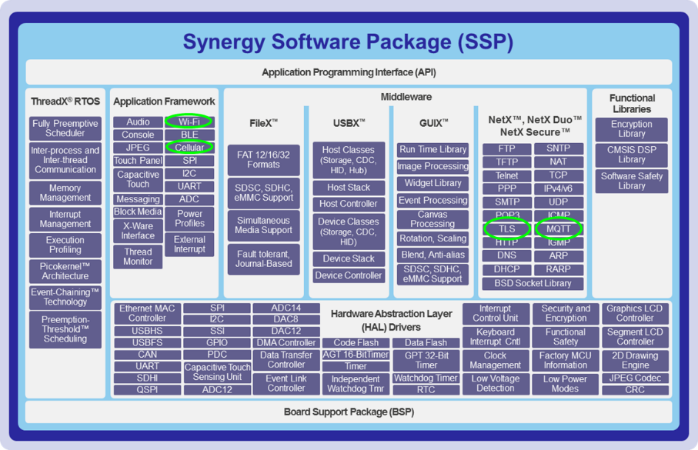



Bringing it all together
Wireless Application Frameworks in SSP for easy WiFi and Cellular implementation
TLS / MQTT for secure network communications between ‘things” and cloud
A means to connect to major cloud service providers with no barrier to get started

Slide 44
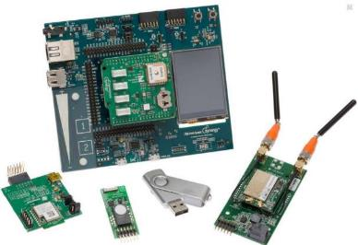
Synergy Enterprise Cloud Toolbox
Sensor Shield
Connect in 10 minutes !
Synergy PK-S5D9 Kit
Software delivered in a Synergy Application Project
Name: Synergy Enterprise Cloud Toolbox
ZIP file of App Note and code projects
Software executes on PK-CLOUD1 kit
Wi-Fi
CAT3 Cellular
PK-CLOUD1
1
Use Synergy MQTT & TLS to connect to cloud vendor of your choice
2
Quickly compare connectivity with Ethernet, Wi-Fi, and Cellular using Synergy Frameworks
3
Visualize sensor data in your own private web based Dashboard
4
Integrate your Dashboard account with your own cloud account
5
Use embedded and Dashboard code as starting point; modify for your own application
RENESAS CONFIDENTIAL

Slide 45
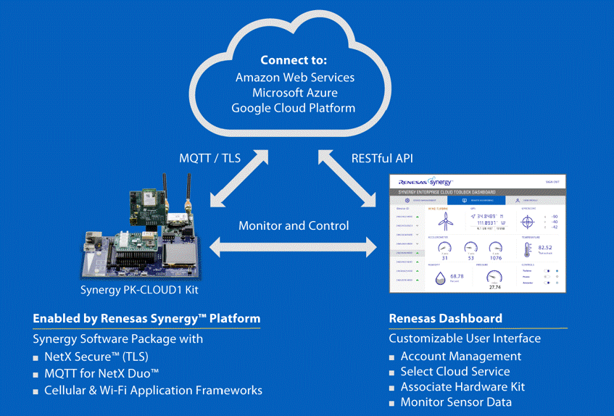
Synergy enterprise cloud toolbox
2
3
Choose an enterprise cloud service
Visualize data and control the kit with the Dashboard
1
Connect a Synergy kit

Slide 46
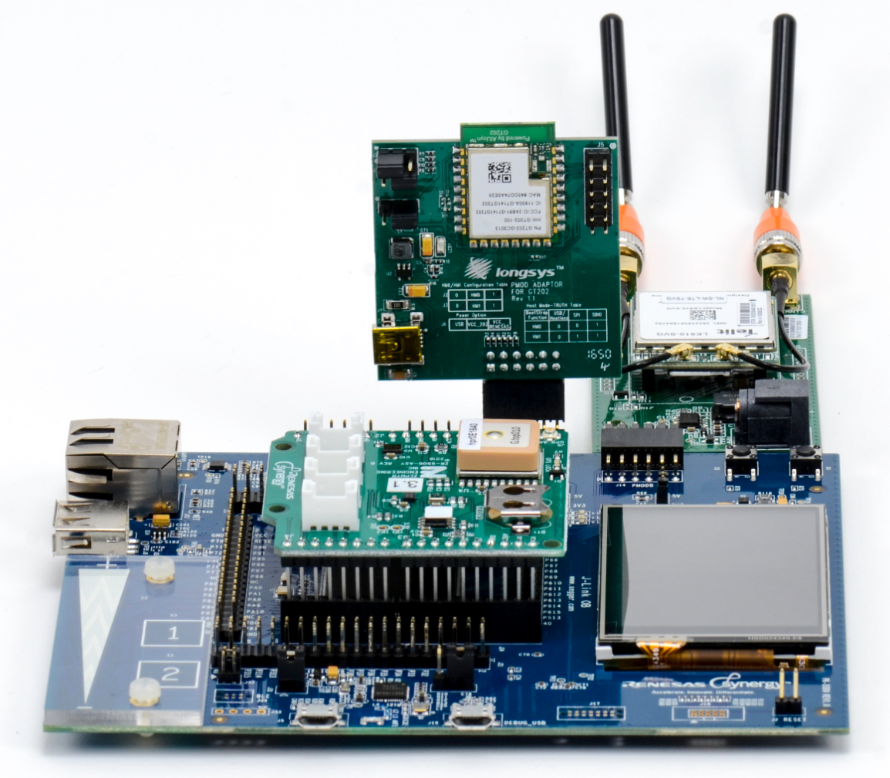
PK-Cloud1 Kit
WiFi Module (Pmod) -
Longsys GT-202 802.11 b/g/n with QCA4002 chipset
Sensor Shield (Arduino)
GPS
Gyroscope
Accelerometer
Temperature
Humidity
Pressure
Cellular Modem (Pmod) - NimbeLink CAT3
Note: Cellular connectivity only supported for USA, Europe, and India
Standard Synergy
PK-S5D9 Kit
Contact your local Renesas sales representative to inquire about receiving a PK-CLOUD1 kit

Slide 47



system architecture Synergy Enterprise Cloud Toolbox
Enterprise Cloud
Amazon Web Service,
Microsoft Azure, Google Platform*
Master accounts - user does not have access
TLS / MQTT
On Dashboard, the user can:
Create an account
Select Enterprise Cloud Service (AWS, Azure, or Google Platform)
Associate kit with account
Determine if kit is online
Monitor sensor data from kit and control kit functions
RESTful API
CLI
USB
Monitor and Control
PK-CLOUD1
User-created accounts
Command Line user Interface (CLI), the user can:
Provision a kit (get the ID, register an email address)
Provision connectivity type (Ethernet, Wi-Fi, CAT3)
Renesas Dashboard
Renesas-hosted Dashboard
* Google Cloud support to be added in October 2017

Slide 48
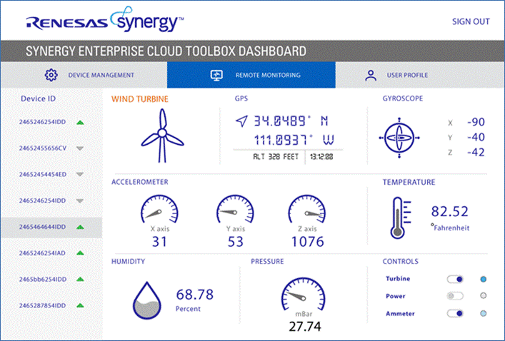
Dashboard features
“Thing” to Cloud
Move PK-CLOUD1 Kit and watch accelerometer readings change
Cloud to “Thing”
Change selections on Dashboard and watch LEDs turn on/off on the PK-CLOUD1 Kit

Slide 49
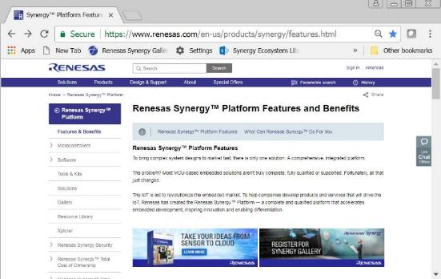
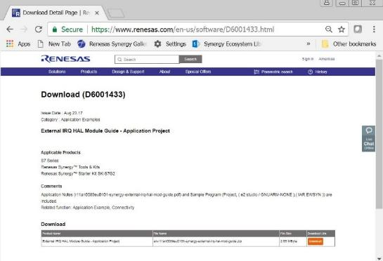
Go from demo to application
Download the Application Project from:
www.renesas.com/cloudtoolbox
Synergy Enterprise Cloud Toolbox Application Project contains:
Synergy SSP project (e²studio and IAR) with C source code
Dashboard with Java/JavaScript source code
Quick Start Guide
Application Note
Use source code as starting place to connect to your own cloud account and add features needed for your application
Synergy Enterprise Cloud Toolbox
S5 Series MCUs
Renesas Synergy Tools & Kits
Renesas Synergy Promotion Kit PK-CLOUD1
Application Note, Sample Programs (e2 studio and IAR ENSYN) are included
Synergy Enterprise Toolbox – Application Project
an-synergy-enterprise-cloud-toolbox.zip
Download

Slide 50
Summary

Slide 51






Renesas Synergy Security solution
Confidentiality
Security Hardware Resources
SCE
Memory protections
Security Software Resources
Crypto Library
Secure Boot Loader and Mastering tools
Secure communication stack (TLS)
Ecosystem partners
Arrow and Avnet for Secure Programming Service
Secure Thingz and Data I/O for Secure Programming equipment
Digicert, Global Sign for Certificate Authority
Integrity
Availability

